Slide 1
ENTRENOVA 8-9, September2016
Rovinj, Croatia
most common times of the year or seasons purchased, and how much product is typically requested per order. The final step of segmentation marketing is identifying quantitative factors, including breaking down the client base to discover less definite information about the clients regarding overall feelings of the brand offered, and intentions to buy. Another type of agribusiness marketing strategy employed with great success is market and client analysis. Most companies have teams of marketing experts on hand to carefully review all of the important information gathered about the current client base, as well as the overall market status. This information is often discovered in the market segmentation reports, and is crucial in providing details for the advertising teams to implement the upcoming advertising campaigns. The effective agribusiness marketing strategy must include some type of marketing or advertising plan. Many food industry businesses outsource this work to specialty advertising firms. These firms use the information gathered in the segmentation and analysis portions of the process to formulate effective tools to attract and keep as many clients as possible through methods such as email advertisements, pamphlets, and direct contact with industry buyers. It is not uncommon for the campaigns to focus primarily on business-to-business relationships at this stage of the food production process.
Agricultural marketing covers the services involved in moving an agricultural product from the farm to the consumer. Numerous interconnected activities are involved in doing this, such as planning, production, growing and harvesting, grading, packing, transport, storage, agro-and food processing, distribution,
advertising and sale (Grahovac, 2005). Some definitions would even include “the acts of buying supplies, renting equipment, (and) paying labor", arguing that marketing is everything a business does. Such activities cannot take place without the exchange of information and are often heavily dependent on the availability of suitable finance. Marketing systems are dynamic; they are competitive and involve continuous change and improvement. Businesses that have lower costs, are more efficient, and can deliver quality products, are those that prosper. Those that have high costs, fail to adapt to changes in market demand and provide poorer quality is often forced out of business. Marketing has to be customer-oriented and has to provide the farmer, transporter, trader, processor, etc. with a profit. This requires those involved in marketing chains to understand buyer requirements, both in terms of product and business conditions.
Digital marketing is the promotion of products or brands via one or more forms of electronic media. For example, advertising mediums that might be used as part of the digital marketing strategy of a business could include promotional efforts made
via the Internet, social media, mobile phones and electronic billboards, as well as via digital and television and radio channels. Digital marketing has developed into an integral component of all communications campaigns and become an important success factor. Online marketing covers all those measures used for marketing products, brands and companies that are based on new media and technical instruments with the aim of encouraging interaction with customers online and offline (Zavišić, 2011). Hoffman et al. (1995) were the first researchers to propose a structural framework for examining the development of commercial activity on the Web. They explored the Web's role both as a distribution channel and as a medium for marketing communication, evaluated the resulting benefits to consumers and firms, and discussed the barriers to its commercial growth from both supply and demand side perspectives. They proposed that the interactive nature of the Web freed customers from their traditional passive role as receivers of marketing communications, giving them access to greater amounts of dynamic information to
420

Slide 2
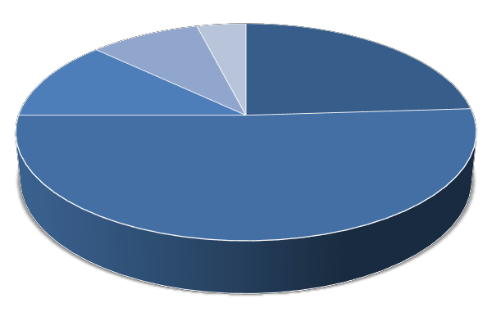
ENTRENOVA 8-9, September 2016
Rovinj, Croatia
support decision making. Hoffman et al also identified benefits for firms, not only in the delivery of information, but also in the development of customer relationships. One example is a digital agricultural system. It’s a database that includes not only various kinds of data relevant to agriculture, ranging from soil conditions to market assessment, but also optimal decision functions that help make better decisions in a series of agricultural production and marketing processes. Such a system is an important agricultural risk management tool, which can help assess risks due to climate change, develop a revenue protection plan for producers, and generate a soil quality management plan (Shen et al. 2010).
Improved agricultural production is the major weapon in the fight against world hunger, improving rural livelihood and increasing economic growth. Agriculture is one of the most important sectors of the nation, and could benefit tremendously
with the applications of ICTs, especially in bringing changes in socioeconomic conditions of the poor in backward areas. Agriculture constitutes a major livelihoods sector and most of the rural poor depend on rain-fed agriculture and fragile forests for their livelihoods. Farmers in rural areas have to deal with failed crops and animal illness frequently and due to limited communication facilities, solutions to their problems remain out of reach (Patel, Sayyed, 2014).
Methodology
The purpose of this paper was to show that digital marketing represents a huge opportunity for Agri-marketers. We took a sample of 200 student respondents to find out their knowledge about agricultural applications. 100 student respondents were from the College of Agriculture in Križevci and 100 students from the Faculty of Agriculture in Osijek. The survey was taken in the period from February until May 2016.
Results
98 % of 200 student respondents use mobile applications in daily life. Only 6% of them use agricultural applications.
Chart 1
Which agricultural application do you use most?
9%
4%
24%
Agri Market
GPS Fields Area Measure Vegetable farming Agren Soil calculator Precision Agriculture
12%
51%
Source: our survey, 2016
Our survey shows that students, even though they have big informatics knowledge, are not interested in trying new technologies, only 14% are opened in new ideas.
421

Slide 3
ENTRENOVA 8-9, September2016
Rovinj, Croatia
Interesting result was gained on the question in witch percent do you think agricultural applications are useful in practice and the answer was 75%. That is not matching with results showed in Table 1 who are referred to knowledge of agricultural applications.
Table 1
How many agricultural applications do you know?
Less than 10 | 84 %
10 and more | 13 %
More than 50 | 3 %
Source: our survey, 2016
In Table 2 we wanted to ask, by their opinion, what is the most important thing in agricultural marketing and in Table 3 the negativities when you sell a specific product. The results are shown below.
Table 2
Importance of selling agricultural products
Quality product | 41 %
Good advertising | 18 %
Price | 24 %
Distribution | 17 %
Source: our survey, 2016
Table 3
Main negativities when selling agricultural products
Rapid deterioration of the 69 % product
Low quality of the product 12 % Negative marketing 4 %
High cost 15 %
Source: our survey, 2016
All 200 student respondents agreed that good marketing can sell specific agricultural products. The problem can be high price and low quality products. 69 % of respondents think that the biggest concern is rapid deterioration of the product which has a short date of use.
Although we say that technology has improved, it has not gone to the rural levels as it is confined to urban areas alone. Just 7% of all student respondents use
agricultural marketing and digital marketing in rural areas all. In urban areas 46% of them uses above mentioned markets.
422

Slide 4
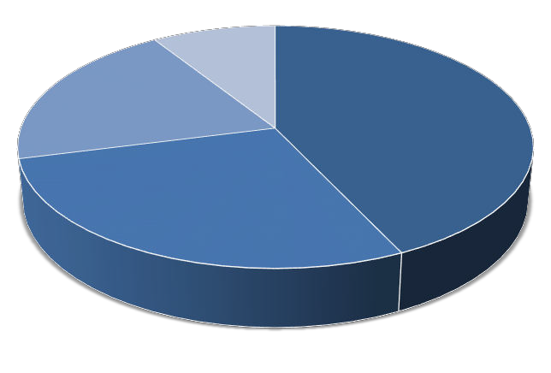
ENTRENOVA 8-9, September 2016
Rovinj, Croatia
Chart 2
For what purpose do you use digital marketing?
9%
20%
43%
Selling the product Advertising
Gathering informations Other
28%
Source: our survey, 2016
Conclusion
There are several challenges involved in marketing of agricultural produce. The government funding for farmers is still at a nascent stage and most of the small farmers still depend on the local moneylenders who are leeches and charge high rate of interest. There are too many vultures that eat away the benefits that the farmers are supposed to get. There are several loopholes in the present legislation and there is no organized and regulated marketing system for marketing the agricultural produce.
In our paper, we wanted to show that digital marketing represents a huge
opportunity for farmers in the future. The things which have to change are limited access to the market information, the literacy level among the farmers (in this point is very low) and multiple channels of distribution of both farmers and consumers.
In the end, results showed very low interest and knowledge about digital marketing, agricultural marketing and agricultural applications at all between students. Even we
took survey in two different areas; in two different Colleges the results were similar. So we can take the conclusion that young, educated people should be more interested in progression of agriculture, because if they do not do that agriculture as it is, will stop in the 21th century. We have to make an effort to research this theme more often.
References
Grahovac P. (2005), “Agricultural Economy”, Golden Marketing (Technical Book), Zagreb
Zavišić, Ž. (2011), “Marketing Basics”, Visoka poslovna škola Zagreb
Shen S., Basist A. and Howard A. (2010) “Structure of a digital agriculture system and
agricultural risks due to climate changes”, International Conference on Agricultural Risk and Food Security, Beijing, China 10–12 June 2010, “Agriculture and Agricultural Science Procedia”, Volume 1, 2010, Pages 42–51
Hoffman, D. L., Novak, T. P., Chatterjee, P. (1995) “Commercial Scenarios for the Web: Opportunities and Challenges”, Journal of Computer Mediated Communication, Special Issue on Electronic Commerce, 1(3).
423

